Slide 1
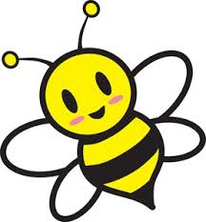
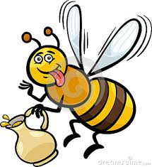
Bees!
By Bronte Hemming's

Slide 2
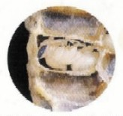
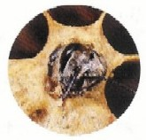
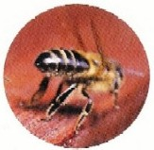
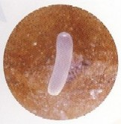
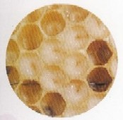
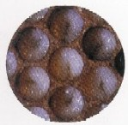
The Life cycle!
1. The queen lays each egg in a different cell of the honeycomb.
2. As soon as the egg is laid, the larva is growing inside it.
3. After three days, the egg hatches and a larva crawls out.
5. Eight days after hatching, the bee larva is fully grown.
6. The larva cannot feed anymore and it starts to change into a pupa.
7. When it's about three to four weeks old, the bee will leave the hive.
4. As the larva grows, it sheds its skin. It does this five times.
DID YOU KNOW THAT….
A bee’s wings beat 190 times a second, that’s 11,400 times a minute!

Slide 3
Pros about having bee hives in your school!!!
Pros
Honey for your school.
More bees to pollinate the garden.
More people can come to our school and learn about bees.
Live model for kids to study.
No need to travel around the place to find bee hives.
You can have more connection with the community.
Money from the sale of honey.
One bee will only make 1/12 of a teaspoon of honey in its entire life

Slide 4
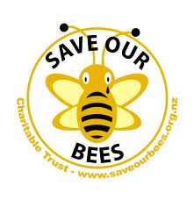
Interesting facts!
A honey bee visits 50 to 100 flowers during a collection trip
The honeybee is not born knowing how to make honey; the younger bees are taught by the more experienced ones.
It is the only insect that produces food eaten by man

Slide 5
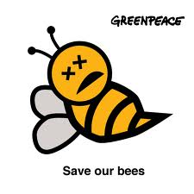
This Is what will happen if we don’t save the bees.
Bees are responsible for 80% of pollination that occurs. So next time you're eating any fruit or vegetable, thank a honey bee!

Slide 6
How you can save them!
1 Stop using insecticides
2 Plant Bee-friendly plants
3 Create natural habitat gardens
4 Find out more about bees
5 Support your local beekeepers
6 Make you own 'Wild bee' house
7 Become a beekeeper
8 Sign petitions banning pesticides
9 Encourage your local authority
to do more to help bees
The Queen bee lays around 2,000 eggs per day! She can also select the gender of the larvae. Most larvae that will be produced will be female.

Slide 7
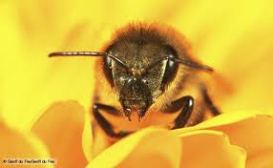
Bees are dying because……..
Bees are dying out because people are using neonicotinoid/sprays on their garden instead of letting mother nature do her job to grow their plants. They are also dying out from diseases from people smuggling honey into our country. Honey is a raw product so it doesn’t have to be cooked which means it will still carry lots of pests and diseases!
It doesn't seem like a lot of things that kill bees but there is many more like when you use your cell phone it can cut off a bees flight path and then it cant get back to its hive and eventually dies

Slide 8
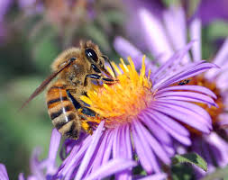
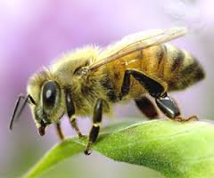
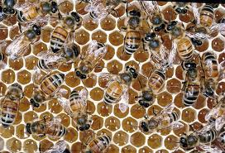
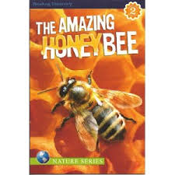
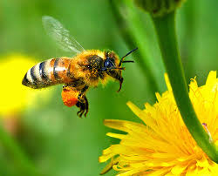
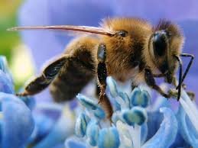
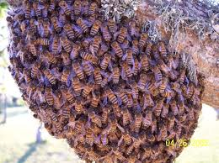
Picture page!!

Slide 9
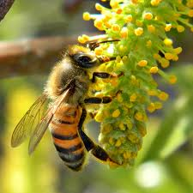
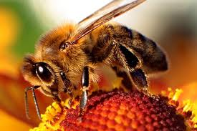
THANKYOU FOR WATCHING MY SLIDESHOW!!

